Slide 1


Visit & Bookmark ALL OUR SITES!
Kids Zone ElksKidsZone.org
Teen Zone ElksTeenZone.org
Marketing Site ElksDap.org
Chairperson Training Training.ElksDap.org
National Website Elks.org/DAP

Slide 2

Kid friendly website containing
Drug Awareness materials including:
- Bigg Milt’s Life Lessons videos
- Coloring books
- Comic books
- Trivia games
- Videos
- Drug education materials and resources
Visit Kids Zone at:
ElksKidsZone.org

Slide 3
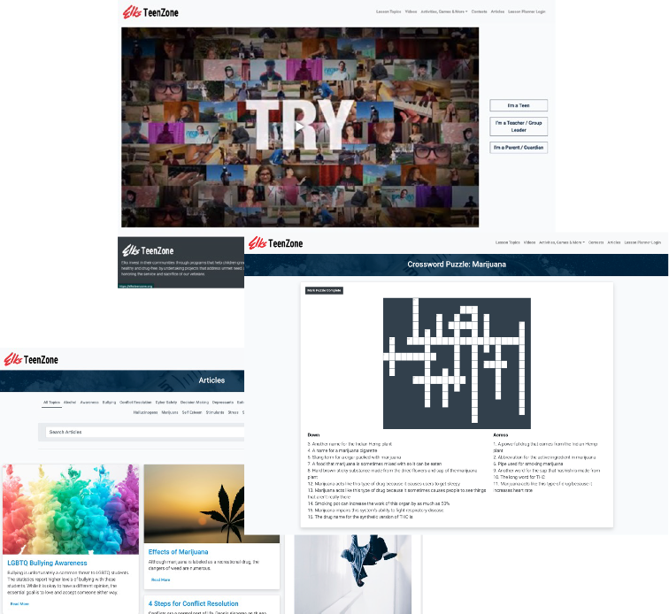
Teen Zone
Drug Awareness resources for adolescents to teens:
- Videos
- Trivia Games
- Crossword Puzzles
- Quizzes
- Student Resources
- Educational Articles
- Online Lessons
Visit Teen Zone at:
ElksTeenZone.org

Slide 4
One of newest online portals to share drug education materials, news and resources developed for parents and teachers by the Elks Drug Awareness Program
- Digital drug education materials
- Videos & media content
- News and articles on Drug Awareness
Visit the Elks DAP Portal at:
ElksDAP.org

Slide 5

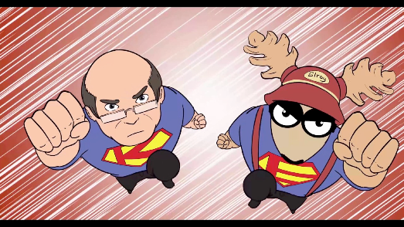
View our ever-growing collection of videos on Drug Awareness with new
material constantly being added
- Awkward Conversations
- DAP Videos
- Video Contest Winners (State & National)
Visit the DAP YouTube page at:
YouTube.com/ElksDAP

Slide 6
Visit Drug Quiz Show at:
ElksDrugQuizShow.com

